Slide 1
Parkour group
Group member: Leo, Shenxin, Alex, Amy

Slide 2
An overview of our Progress
All Maps done
All basic abilities / functionalities done
Game process design done
UI done (under the process of optimization)

Slide 3
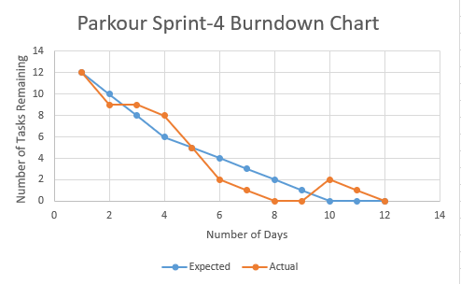
Progress of our project (Burndown Chart)

Slide 4

What we have done in this phase
Scoreboard: used to count the score of players in real time.

Slide 5

What we have done in this phase
Timer: on the top of the screen to show the time left for the current round

Slide 6
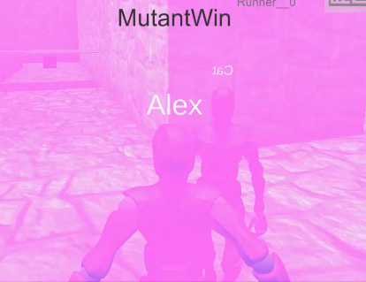
What we have done in this phase
Skill of mutant: can mute the runners in a certain range around him

Slide 7
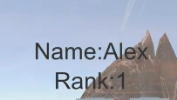
What we have done
A simple ranking system which will show your rank at the end when you finished in the parkour mode.

Slide 8
What we are going to do
Debug and optimize all functions

